Slide 1

Preliminary Zn(n,p)Cu Data
Andrew Voyles
22 February 2016

Slide 2
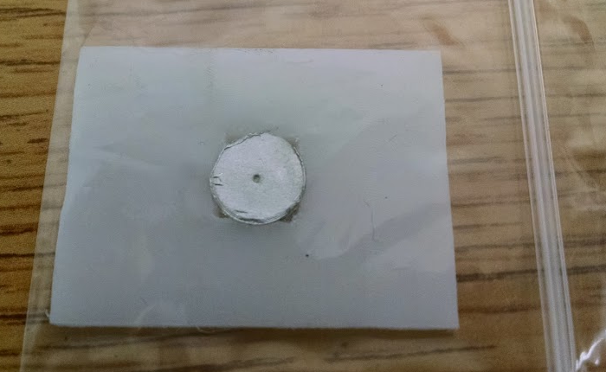
Experimental Setup – 03 Nov 2015
Zinc
Polyethylene
Zinc
Thickness: 1.03 ± 0.01 mm
Diameter: 9.90 ± 0.15 mm
Weight: 0.5375 ± 0.0001 g
Indium
Thickness: 0.48 ± 0.02 mm
Diameter: 9.77 ± 0.12 mm
Weight: 0.2475 ± 0.0001 g
Beam On: 2:13:16 PM
Beam Off: 5:13:16 PM
Start of Counting: 5:43:01 PM
Indium

Slide 3
336 keV - 115m In IT Decay
391 keV - 113m In IT Decay
417 keV - 116 In β- Decay
511 keV - 64 Cu β+ Decay

Slide 4
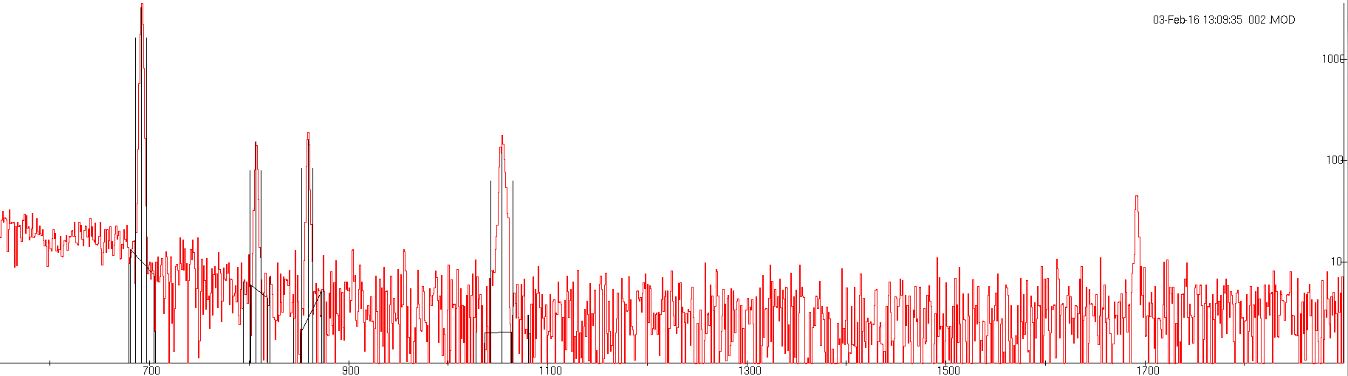
Background Subtracted
336 keV - 115m In IT Decay
391 keV - 113m In IT Decay
417 keV - 116 In β- Decay
511 keV - 64 Cu β+ Decay

Slide 5

Fitting to Model

Slide 7
Results
 | T ½ (ENSDF) | T ½ (Measured) |  |  |  | Χ^2/DoF | #σ above ENSDF
Counts (336 keV) | 4.486 h | 4.519 | ± | 0.0457 | h | 1.7286 | 0.722
Counts (391 keV) | 99.476 m | 104.5208 | ± | 5.6701 | m | 1.721 | 0.890
Counts (417 keV) | 54.29 m | 52.0074 | ± | 2.6139 | m | 1.021 | -0.873
Counts (511 keV) | 12.701 h | 11.8183 | ± | 0.7027 | h | 1.6785 | -1.256

Slide 8
Q_{β} = 3.278 MeV

Slide 9
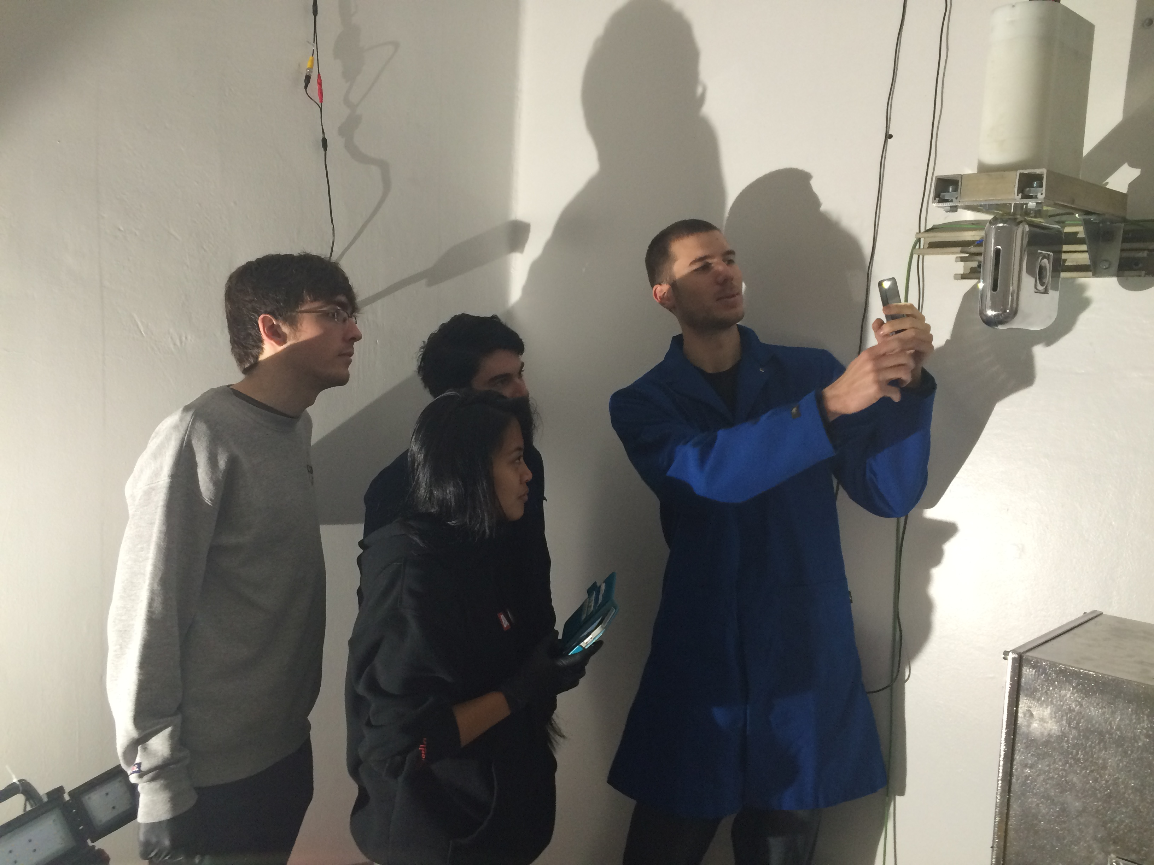
Experimental Setup – 11 Feb 2016
Zinc
Thickness: 1.03 ± 0.01 mm
Diameter: 9.85 ± 0.15 mm
Weight: 0.4514 ± 0.0001 g
Indium
Thickness: 0.51 ± 0.02 mm
Diameter: 9.786± 0.12 mm
Weight: 0.2481± 0.0001 g
Beam On: 2:40:30 PM
Beam Off: 6:02:00 PM
Start of Counting: 6:37:25 PM
Zinc
Polyethylene
Indium

Slide 10
Q_{β} = 3.278 MeV

Slide 11
Q_{β} = 3.278 MeV

Slide 12
Q_{β} = 3.278 MeV

Slide 13
Results – Removal of 511 Contamination
 | T ½ (ENSDF) | T ½ (Measured) |  |  |  | Χ^2/DoF | #σ above ENSDF
Counts (336 keV) | 4.486 h | 4.519 | ± | 0.0457 | h | 1.7286 | 0.722
Counts (391 keV) | 99.476 m | 104.5208 | ± | 5.6701 | m | 1.721 | 0.890
Counts (417 keV) | 54.29 m | 52.0074 | ± | 2.6139 | m | 1.021 | -0.873
Counts (511 keV) (cut 1st 4hrs ) | 12.701 h | 12.0791 | ± | 1.0704 | h | 1.7616 | -0.581
Counts (511 keV) (11 Feb Run) | 12.701 h | 11.8804 | ± | 0.8377 | h | 1.1299 | -0.980

Slide 14
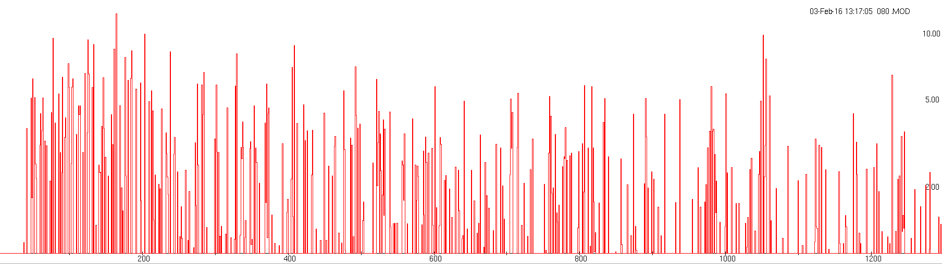
67Cu Peaks – 80 hrs into count
184.5 keV - 67 Cu β- Decay

Slide 15
Next Steps
Need to apply correct detector efficiency calibration
Will not affect half lives of peaks, just XS calculations
Calculate ⁶⁴Cu production XS, relative to In
XS appears to be ~50 mb
Preparing for (n,p) measurements on:
50Ti(n,α),47Ca
105Pd(n,p)105Rh
159Tb(n,p)159Gd
Extend measurements to E_{n} ≤ ~55 MeV, using 88” Cyclotron ⁷Li(p,n) quasi-monoenergetic neutron source (currently in development with Jon Engle [LANL])
Measure ⁶⁷Cu production cross section using LEPS
184.5 keV peak masked by U/Pb decay chain, Compton background
Also inhibited by lower production XS
Use enriched ⁶⁷Zn target?

